Slide 1
Mandatory Corporate Law as an Obstacle to Venture Capital Contracting in Europe: Implications for Markets and Policymaking Luca Enriques, Casimiro A. Nigro, Tobias H. Tröger CEPR, ESM & EUI Conference EU Savings and Investments Union: Bringing Capital Markets to People and Firms ESM Premises, Luxembourg June 4, 2025

Slide 2
Roadmap
Research questions: Do Italian and German corporate laws prevent efficient US-style VC contracting in these jurisdictions and what to do about it?
What do we know about the interrelation of VC markets and the institutions of corporate law and governance?
How do German and Italian corporate laws impede efficient US-style VC contracting?
What are the policy implications?

Slide 3
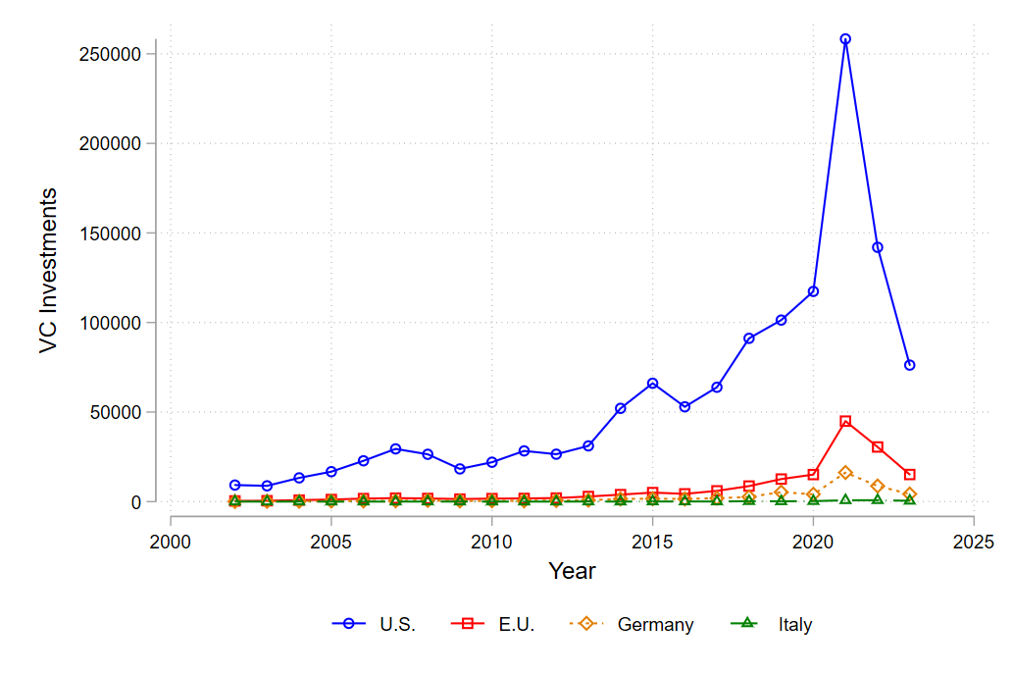
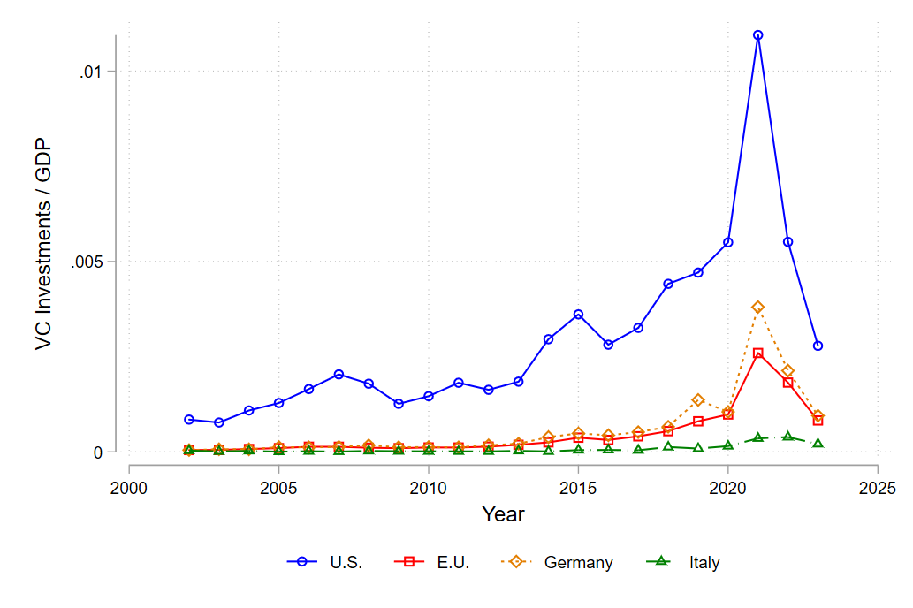
US & EU VC markets
Figure 1. VC investments (seed up to L-Series) in the U.S., E.U., Germany, and Italy over the period 2002-2023 (in USD million).
Data source: Preqin, 2024.
Figure 2. VC investments (seed up to L-Series) in the U.S., E.U., Germany, and Italy over the period 2002-2023 scaled to GDP (in USD million).
Data sources: Preqin, 2024; World Bank, 2024.

Slide 4
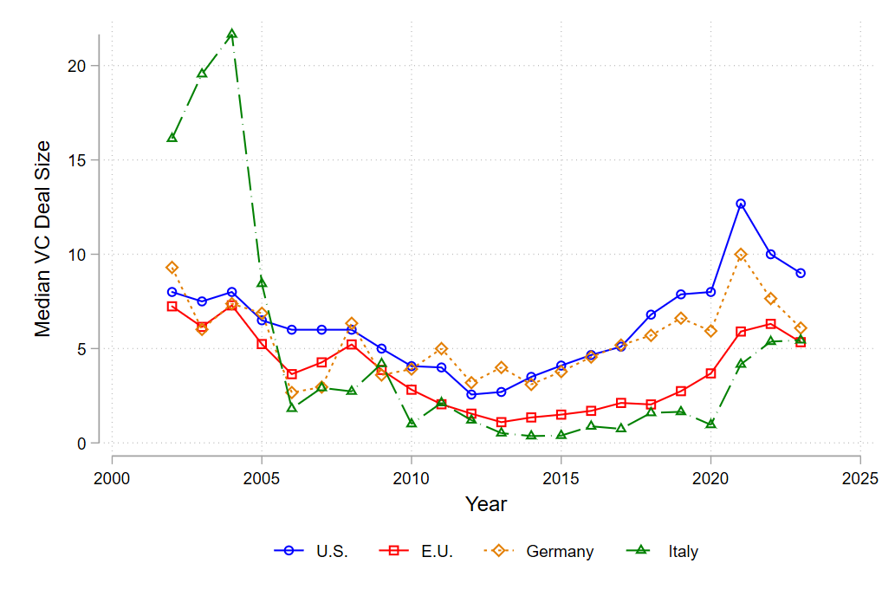
US & EU VC deals
Figure 3. Median size of VC deals (seed up to L-Series) in the U.S., E.U., Germany, and Italy, over the period 2002-2023 (in USD million).
Data source: Preqin, 2024

Slide 5
VC and institutions: the irrelevance view
Vast literature on interrelation of institutional environment and VC markets, including influence of corporate law, e.g., Allen and Song (2003), Lerner and Schoar (2005)
Kaplan et al. (2007)
“…analyze how the contracts allocate cash flow, board, liquidation, and other control rights.
and find “[i]n univariate analyses, contracts differ across legal regimes. US style contracts are more typical in common law countries. However, there appear to be few institutional impediments to implementing US style terms. More experienced VCs are able to implement US style contracts regardless of legal regime.”
Private ordering solutions prevail in a Coasean bargain (default corporate contract)

Slide 6
VC and corporate law: a more granular view on efficient contracting
Focus of standard L&F literature on general corporate law quality – as reflected in indices (!) – may not capture the pivotal variable in our context
Corporate law matters as background against which VCs and entrepreneurs structure their relationship
Relative flexibility or rigidity of corporate law affects contract design and enforcement with efficiency implications
(re-)design of corporate contract causes “shapeshift” of the firm to achieve highest value structure for contracting parties
Corporate law impediments increase transaction costs, reduce contract value and precipitate higher cost of capital

Slide 7
Corporate law as determinant of shapeshifting success
private ordering exercise causes transaction costs
Corporate law’s properties (rigidity vs. flexibility) affect magnitude of these costs by
preventing the adoption of efficient solutions altogether
increasing the transaction costs associated with it, both ex post and ex ante
At the margin, rigid corporate law can prevent deals and VC investments

Slide 8
VC contracting under US (DE) and GER/ITA corporate laws
US corporate law hospitable towards private ordering
Flexible → state contingent cash-flow and governance rights
largely standardized & presumably enforceable contracts (thanks to NVCA)
deferential judicial enforcement → policing opportunism
EU corporate laws “in action” significantly less open vis-à-vis efficient shapeshifting
Courts, legal scholars, and practitioners (e.g., notaries) focused on ex post fair outcomes
Non-VC specific legal doctrine instrumentalized to intervene in contractual allocation of cash-flow and governance rights

Slide 9
The example of liquidation preferences
U.S. VC contracts grant VCFs a preferred claim on the proceeds of liquidity events, e.g. the sale of the venture, encompassing the original investment and dividends
Allows entrepreneurs to signal their determination and trust in the venture
Incentivizes entrepreneurs to provide optimal effort
Protects VCF against downside risk and entrepreneurial opportunism
German law prohibits any shareholder from receiving a “disproportionate” fraction of firm value → judicial review
Neglects mutually beneficial economic logic of VC contracts in poorly performing ventures

Slide 10
Policy implications
Can we replicate US-style VC contracts in GER, ITA… (Continental) Europe? Not really!
Corporate law in action matters directly for VC contracting and affects both contract design and functionality
VC contracts are less valuable tools to structure investment relationships, which at the margin can affect investments
How thin/thick is the margin? When the tide goes out…
Reforms need to overcome root cause of constraints
Promulgation of new, laxer rules won’t do!
Autonomous (28th) regime that limits court interventions (standard charter)

