Slide 1
CMU REDUX:
Towards a deeper and more accessible savings and investment union
Loukas Kaskarelis, Arndt Kund, Mathias Skrutkowski, Juan Solé
May 8th, 2025

Slide 2
Why another paper on cmu?
The Context
Renewed focus on CMU, rebranded as SIU…
→ large investment needs identified (Letta, Noyer, Draghi)
→ need for EU’s strategic autonomy continues to grow
…So far the CMU project has focused on:
  Top-down solutions
  Harmonization issues; regulation; supervision
ESM contribution in a nutshell
“Propose measures to mobilize higher retail investments
while safeguarding financial stability”

Slide 3
3 focus areas: diagnosys and recommendation
Well-designed incentives and pension reforms → Expand range of financial vehicles (especially equity-like) (Ch. 1, 2, and 3)
Boost cross-border retail investment → Reduce financial fragmentation and increase stability (Ch. 4)
Revive securitisations → Widen access to corporate credit markets and attract broader investor base (Ch. 5)

Slide 4
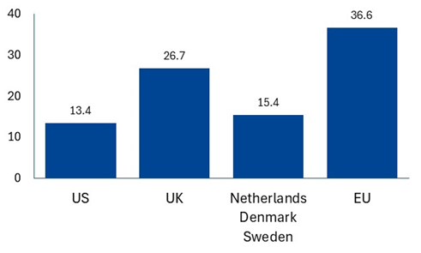
THE (RETAIL) MONEY IS THERE BUT...
European consumers are wealthy and thrifty BUT…
…allocate savings conservatively.
And financial wealth is unevenly distributed.
Households’ deposits and cash holdings
(in % of financial assets)
Households’ wealth distribution across selected assets (in % by decile)

Slide 5
Calibration of Tax incentives: higher penetration vs. Fiscal cost
Tax preferential investment savings accounts
Capital gains tax (% total tax revenue 2006-23)
 | Plan d’Epargnes en Actions (France) | Piani Individuali di Risparmio (Italy) | Investerings- sparkonto (Sweden)
Restrictions on asset allocation | Min. 75 % in European companies | Min. 70 % in European companies with a permanent establishment in Italy | No restrictions
Tax treatment | Five year holding period for tax exemption | Five year holding period for tax exemption | Capital gains tax applied to an imputed return (risk-free rate plus one percentage point)
Minimum holding period | 5 years | 5 years | No restrictions
Aggregate balance (€ bn) | 101.0 (as per 2022) | 19 (as per 2023) | 150 (as per 2023) (SEK 1 665 bn)
Share of GDP | 3.5% | 0.8% | 27%

Slide 6
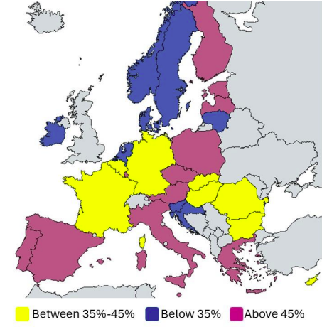
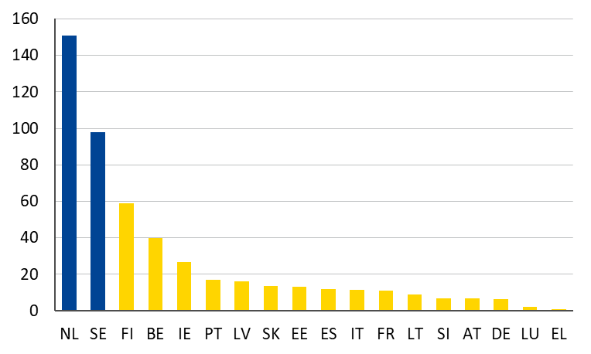
Retirement savings could play a bigger role in the CMU
Funded pensions vary across countries..
.. and correlate negatively with replacement rates of Pillar 1 PAYG schemes
Assets earmarked for retirement (% of GDP)
Source: OECD
Source: European Commission, ESM

Slide 7
Could Pension system reform be the needed catalyst?
Household wealth is higher in countries with less generous PAYG schemes
Lower PAYG entitlements drive funded pensions and stock market capitalisation
Source: OECD, EC report on ageing and pensions
Source: World Bank, CEIC, EC report on ageing and pensions

Slide 8
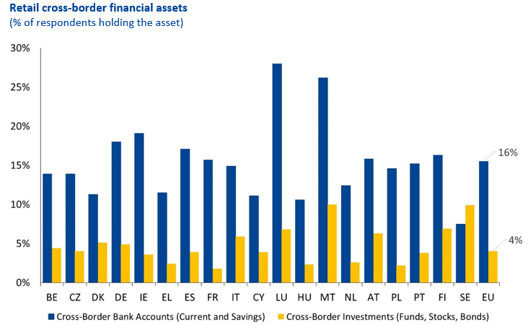
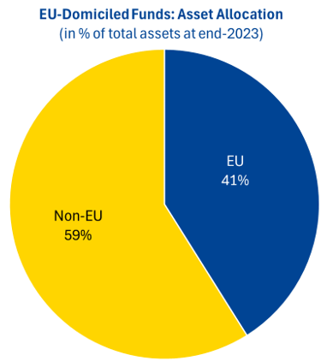
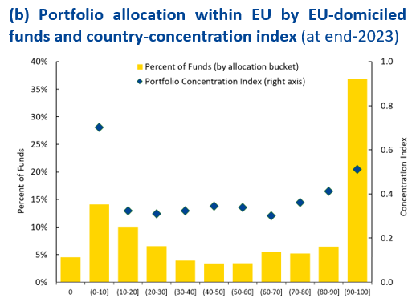
EU retail investments exhibit Excessive home bias...
Direct cross-border investments remarkably small for 25yo monetary union
International investments skewed towards non-EU—mostly US.
Asset diversification across EU countries is rather low

Slide 9
Making Banks Part of the Capital Markets Solution
EU securitisation and covered bond issuance volumes close to US non-agency securitisation (in € bn)
Sources: AFME, Dealogic

Slide 10
AN EU Platform to Power SME growth and CMU
Why SMEs?
The Solution: An EU securitisation Platform
Standardises issuance and disclosures.
Enables cross-border pooling and broader investor participation.
Public guarantees derisk specific tranches
Can be linked to dual-transition.
Builds on proven national models (HAPS, GACS). Backed by ECB, Eurogroup and the Noyer report.
Drive EU jobs, innovation, and long-term growth.
Heavily reliant on bank credit, limiting growth and risk diversification.
The Problem
SME loans are too diverse and unsecured for covered bonds.
EU securitisation market remains fragmented, underused, and administratively complex.
What It Delivers
Lower costs, greater transparency and better data access.
Scalable SME securitisation aligned with CMU/SIU and EU goals.
“By unlocking bank balance sheets and widening investor participation in SME loan portfolios, securitisation does more than offer a new financing instrument – it aligns with CMU’s aim of deepening cross-border market and propelling productive investment across Member States.”

Slide 11
policy recommendationS: Three key areas
1. Foster greater retail participation
Programs to match retail investments in equity-like vehicles
Gear tax rewards to middle- and lower-income groups
Set up tax-advantaged savings and investment accounts
2. Boost pension savings/investments
Strengthen incentives for funded retirement savings
Enable pension funds to pursue more active asset management
Limit extent of investment guarantees
3. Make banks part of the CMU solution
Explore a pan-EU infrastructure to support SME securitisation

Slide 12
ANNEX - policy recommendations

Slide 13
ANNEX - policy recommendations

