Slide 1

Capital Markets Union: a deep dive
Five measures to foster a single market for capital
04/06/2025
Daniel Kapp
European Central Bank

Slide 2
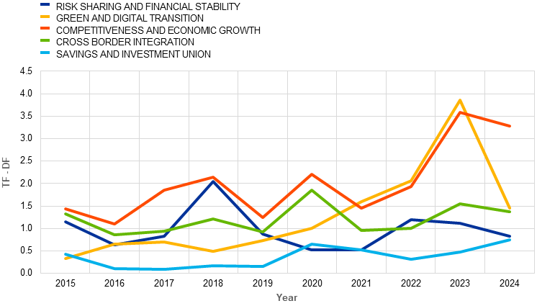
From complementing banks to powering transitions
From a macro-stabilisation tool to savings and investment union
Back in 2015, narrative around cross-border integration and risk sharing
In 2024, CMU to foster competitive and economic growth and support the twin transition
Notes:
Deployed web-scraping and LLM methodologies to understand how CMU proposals evolved over time, to have a better understanding of:
How CMU narrative evolved
Who is supporting what in current debate
What exactly different stakeholders are proposing in more detail
The CMU narrative has significantly evolved over time, to reflect macroeconomic developments and new challenges
From being a macro-stabilization tool in 2015, with strong focus on cross-border integration and risk sharing
To being a key tool to foster competitiveness and economic growth
Rising trends on twin transition and digitalization

Slide 3
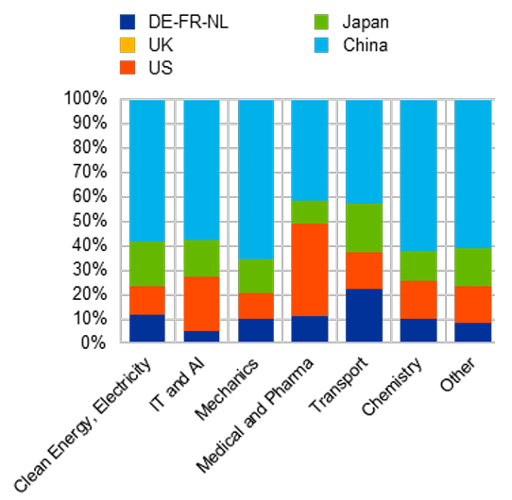
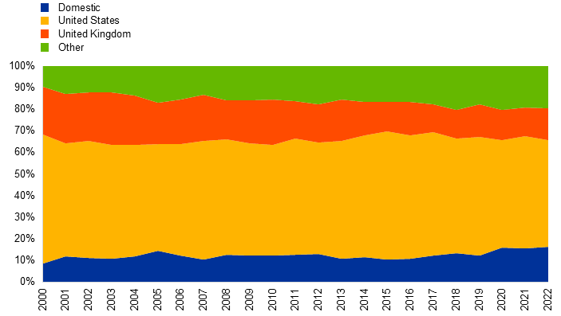
Innovation needs equity, not just credit
Innovation lags behind in Europe, and lacks domestic investors
Patents applications by sector (2022)
Share of capital in EU tech companies…
…While 80% of investments in US tech companies is domestic
Source: WIPO database, Pitchbook, ECB calculations
Notes:
We keep mentioning the need to finance innovation and support competitiveness – here you can find a couple of charts to support diagnostic
Innovation lags behind in Europe, and lacks EU investors
Chart on left hand side shows patent applications by sector: European countries have hard times competing with US and China, and even more so in IT and AI as most EU applications are in traditional sectors such as automotive
Chart on right hand side shows the share of investors in EU tech companies: approx 60% of capital comes from US investors, while this is not reciprocated as 80% of investments in US tech companies is domestic

Slide 4
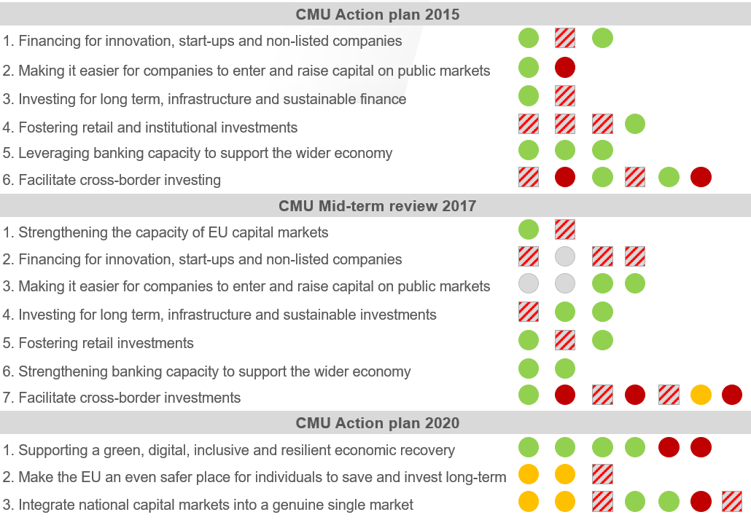
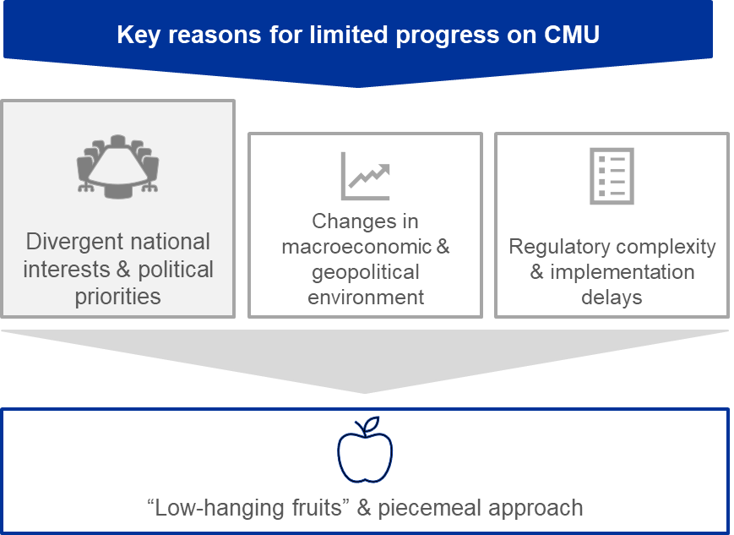

Policy progress has been real, but…
Intense regulatory activity, but political obstacles, vested interests and technical complexities held back key reforms
Notes:
Intense regulatory activity by the Commission: 3 CMU action plans, 55+ regulatory proposals & 50 non-legislative initiatives. Each marker represents one legislative (dot) or non-legislative (square) proposal. Different colors indicate different state of play (concluded, ongoing, failed or addressed in another action plan)
Majority of proposals implemented, but many watered down in the process: Several reforms on taxation, insolvency, pensions, supervision stalled
Despite regulatory efforts and improvements, EU capital markets have not reached sufficient levels of depth, volume and integration (CMU indicators)
Negotiations often diluted original proposals leading to complex/unviable results, in some cases no progress at all
Contingent circumstances (e.g. Covid, geopolitical tensions) sidelined CMU priorities
Policymaking and technical challenges (e.g. process, gold-plating, national transposition)
Savings and investment union at the core of new Commission (see SIU strategy, competitiveness compass and ReArm Europe)

Slide 5
…fragmentation persists
Price-based and quantity-based financial integration composite indicators
(quarterly data; price-based indicator: Q1 1995 – Q3 2024; quantity-based indicator: Q1 1999 – Q2 2024)
Source: FISEA report (2023)

Slide 6



Five key priorities for the next legislative term
Starting from GovC statement, focus on a subset of priorities to achieve impact through implementable solutions
GovC statement
5 priority areas
3 key actions
Securitisation
Integrated supervision
Targeted harmonisation of laws
Post-trading harmonisation
Solve debt bias in taxation
New technologies (tokenisation)
Pan-European financial markets
Pan-European rulebook for securities settlement and collateral
Central clearing capacity in EU
Promote listing
Financial education
European Single Access Point
To create scale
Savings product
Venture capital financing
Securitisation
To integrate
Integrated supervision
Trading, post-trading and digital tools
Entering
Savings product
Expanding
Trading and post-trading
Supervision
Securitisation
Exiting
Venture capital financing
See ECB President speech.
Notes:
Starting from the GovC statement, we focused on narrowing down the CMU priorities to achieve impact, while proposing realistic and implementable solutions
From 12 identified actions in the GovC statement
To 5 priority areas to create scale and integrate capital markets
To three, key actions as highlighted by the President in her speech last week
Entering capital markets, via savings product
Expanding capital markets across borders, via consolidation of trading and post-trading landscape
Channeling funds to support innovation via Venture Capital financing
Within this framework, two further actions are considered: supervision, to facilitate cross-border convergence; and securitisation, to free-up banks’ balance sheet and support the real economy
The renewed political momentum creates a window of opportunity to make concrete progress on CMU
This renewed political momentum is reflected in a proliferation of position papers and policy proposals to advance the CMU agenda. While this rich debate is definitely inspiring, we must be able to identify proposals that focus on preserving vested interests.
Among member states, there’s full agreement on the need for action: views however diverge on what solutions are most impactful to make progress
This mood is reflected in EU fora, where Eurogroup published a high-level statement on the importance of capital markets in Europe but fell short of concrete actions.
More recently, the Commission published the SIU strategy which highlights the importance of national measures, also recalling that private capital is necessary to support the competitiveness compass as well as RerArm Europe (and defense expenditure)
This slide summarises the proposals in the ECB paper, that my colleagues will explain later in more details
We identified five priorities, to unlock 3 key areas of action (the three Es):
Entering capital markets, via a European savings standard
Expanding capital markets across borders, via a review of the trading and post-trading landscape and the support of digital technologies; integrated supervision; securitisation
Exiting capital markets to ensure capital is invested to support innovation and competitiveness
The SIU strategy by the Commission published last week is definitely broader in scope – and also includes Banking Union.
At the same time, the ECB priorities are very consistent with the SIU agenda in terms of CMU topics covered
Investments and financing includes:
Promoting Investment in Equity and Certain Alternative Asset Classes
Aligning Public Funding instruments with Savings and Investments Union Objectives
Investment Exits
Taxation
Securitisation
Integration and scale includes
Consolidating Trading and post-Trading Infrastructures
Further Developing the Asset Management Sector
Capital markets are particularly needed in Europe at the current juncture to support economic growthk, competitiveness and open strategic autonomy.
In this context, five are the key objectives that CMU can help supportin:
Financing innovation
Supporting the digital and green transition
Supporting people’s pensions and wealth during retirement
Strenghtening private risk sharing and resilience
Ensuring more inclusiveness and cross-border convergence
From an ECB perspective, capital markets are also key as they impact monetary policy transmission and medium-term price stability;
Speed and depth of MP pass through, and cross-country differences
Release other stabilisation tools
Impact on productivity

Slide 7
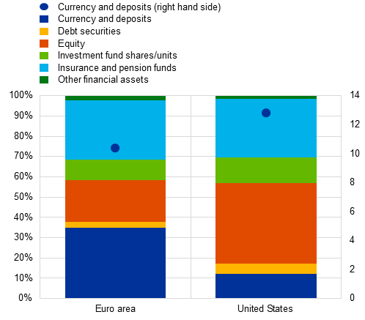
Retail investors: a sleeping giant
Households’ financial assets
Limited returns imply lower retirement wealth
1
% and EUR trillion
2
Strained state-funded pensions, especially with limited fiscal space
3
Missed opportunity to redirect savings toward productive investments, domestic priorities and competitiveness
Within-EU fragmentation: Denmark, Sweden and the Netherlands similar to U.S.
Roots: different pension systems, tax incentives, savings products offered, financial literacy
Notes:
Starting with the first E – Entering capital markets – there’s common agreement that the way EU citizens save is suboptimal.
While the saving rate among EU households is even higher than in the US, 40% of retail financial assets are held in cash and deposits – compared to only 10% in the US: you can see that as the blu bar in the histogram here.
The fact that households do not invest in capital markets has three important consequences:
They receive limited returns, which means that they will benefit from a much lower wealth during retirement
State-funded pensions will be under pressure, which is an even bigger issue due to limited fiscal space
Savings are not directed towards productive investments to support competitiveness

Slide 8



An EU savings standards
To mobilise deposits and channel resources to strategic EU sectors
Design
Proposal
complementarity
Tax incentive
Calibration
Guaranteed vs market returns?
EU-level
National
Collect best practices
Define EU-wide standards and design features
Support national efforts for national implementation
Define implementation features (tax, link with pension system)
Implement savings product
Financial literacy
Product design
Fee structure, portfolio composition, holding period, …
Product, account or label?
EU-level vs national measures
Notes:
Tax incentives are essential to:
Incentivize retail savers, also to invest in higher-return longer-term products
Increase stock of capital market funding
Support strategic sectors/regions
Important elements include
Tax break calibration
Trade-off between guaranteed and market performance returns
EU centralisation vs national harmonization is essential to:
Ensure implementation feasibility
Extend opportunities throughout the EU
Important elements include:
Country-specific tax regimes, pension systems and fiscal space
Cross-border investments
Common standards and investors’ confidence
Portability
Product design is essential to:
Incentivize retail savers and financial intermediaries
Ensure implementation feasibility
Important elements include:
Fee structure
Portfolio composition
Minimum holding period
Auto enrollment possibilities
Product vs account vs label
Balancing different features to align stakeholders’ incentives:
Return optimization vs EU focus
Tax incentives and fees
Guaranteed returns vs risk profile
EU vs harmonised national initiatives
New stream of work internally, on newly prominent topic in CMU debate
Compares national initiatives (successful and not)
Identifies best practices
Analyses levers and possible combination of EU-wide and national approach.

Slide 9
Fragmented trading and post-trading
Trading
Post-trading
295
14 + 32
Trading venues in the EEA across all market segments
14 CCPs and 32 CSDs in the EEA
56 -68%
On-venue trading that took place on domestic exchange
4%
Cross-CSD settlement as a share of the total volume of transactions (2024)
Smaller exchanges particularly shallow and illiquid
Pan-European groups have emerged, but infrastructure not consolidated
Different regulatory and tax regimes
Lack of transparency, inefficiencies/cost, reduced liquidity
Notes:
United States: The U.S. has a much more consolidated infrastructure, dominated by just 1 major clearinghouse (the Depository Trust & Clearing Corporation, DTCC) that handles most clearing and settlement for the entire market.United Kingdom: The UK operates 2 primary clearinghouses—LCH (London Clearing House) and ICE Clear Europe—as well as Euroclear UK & Ireland for securities settlement.
EU trading markets, for instance, are significantly less liquid than their US counterparts: the average daily trading volume per company is 1.3 higher for US large-caps (€5 bn to €100 bn in market capitalisation) and 2.0 times higher for US mid-caps compared with their EU counterparts. Monthly turnover velocity in the EU was 52% for equities and 21% for corporate debt, compared with 145% and 39% in the US respectively. Ultimately, lower liquidity affects capital market development: the total value of securities issued in EU CSDs increased by 51% from €31.2 tn in 2009 to €47.2 tn in 2023, whereas the value of securities issued in US CSDs increased by 125% from € 79.4 tn to € 178.6 tn. Likewise, fragmentation in the post-trading landscape has held back cross-border settlement, with cross-CSD settlement remaining at a very low level of about 4% of the total volume of transactions as of 2024. This results in frictions and thus allocative inefficiencies, including higher home bias.
See Euronext, “Demystifying the liquidity gap between European and US equities”, April 2024.
See Oliver Wyman, “The Capital Flywheel: European Capital Markets Report”, May 2024 (link).
See Born, A., Heymann, D., Chaves, M. and Lambert, C. (2022). “Frictions in debt issuance procedures and home bias in the euro area”, Report on Financial Integration and Structure in the Euro Area.

Slide 10
Integrating trading and post-trading, and deploying new technologies
Support cross-border transactions and deepen liquidity pools
First step
End-goal
Integrate
Consolidate
Consolidated tapes
Inclusive equity indices
Harmonised corporate actions
Extend/review DLT Pilot Regime
28th regime for corporate / securities laws
Consolidated infrastructure
Harmonised corporate and securities laws
Deployment of new technologies (e.g.DLT)
Harmonise from the outset
Step-wise approach to overcome legal obstacles to consolidation
Notes:
Digital EUR and DLT technologies can accelerate integration, new opportunities

Slide 11
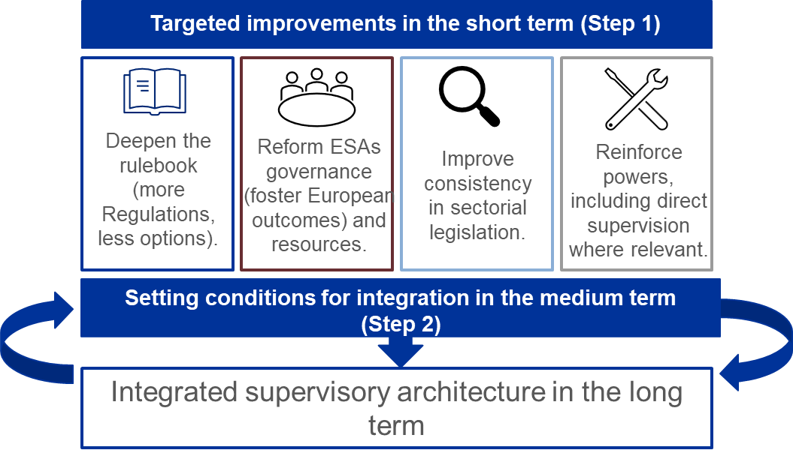
Supervision to foster market integration
Supervisory ecosystem should facilitate market integration and development; it impacts ECB’s role in FMI oversight.
Supervisory ecosystem is complex and fragmented
Different approaches for different segments/actors
Enforcement split across several regulators
1
2
Risks (e.g. cross-border spillovers) potentially overlooked
3
Market development and integration affected
Notes:
Diagnosis:
- Integration of the supervisory framework has been incremental and inconsistent (ESAs was envisioned as transition towards more integrated fmk as capital markets integrate; SSM was created as crisis response and major overhaul but subsequent ESAs review added new activities without reviewing fundamentally the approach).
- Csq:
- Supervisory ecosystem is complex and fragmented
- Costs, uncertainty for stakeholders and risks potentially overlooked
- Different approaches for different segments/actors
- Supervisory ecosystem can be supportive of market development/integration…

Slide 12
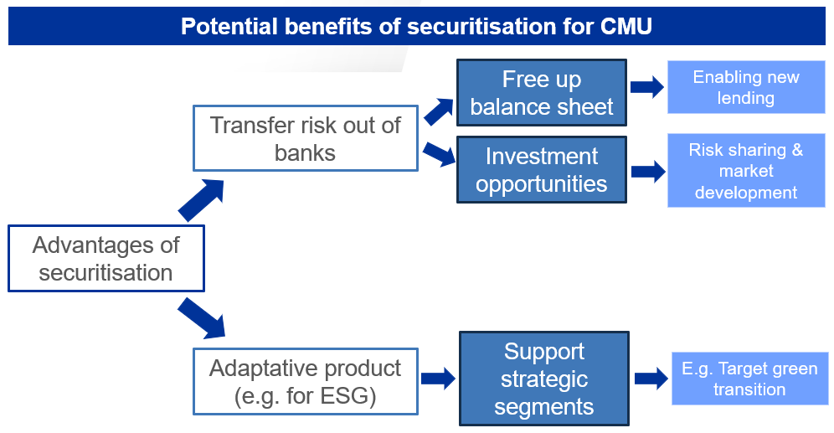
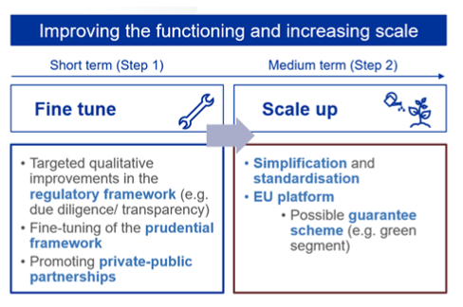
Securitisation. A tool to support CMU
Possibly to channel capital to new lending and support some CMU objectives
To consider
Role of agencies in the US explain difference in size
Regulatory changes only one factor explaining market developments (supply/demand factors) – lack of standardisation is key feature
Use of securitisation by banks: true-sale and covered bonds for funding (retained), synthetics for risk transfer
Notes:
Securitisation is quite flexible and can be used for specific market segments - for example to attract new investors in ESG markets.
Expected benefits of a well-functioning securitisation market:
As a funding tool, it can contribute to a well-diversified funding base
As a risk transfer tool, it can free up bank capital (capital relief), allowing banks to extend new credit to the real economy
As a bridge between the banking sector and capital markets, it can provide long-term investors with a broader pool of assets
On diagnosis in EU/US:
EA securitisation issuance subdued if one focuses on true-sale, but synthetic issuance offers a much more dynamic perspective
US market is dominated by GSEs (no such actor in the EU)
Market dynamics in EU shows specialisation, ie banks used CBs for funding and synthetics for risk transfer; true-sale ABS resilient while RMBS declined alongside increase of covered bonds
Much of the synthetic issuance is for capital optimisation purposes and unclear how much of the capital release is channelled back into funding
There is no evidence that banks lack access to necessary funding and risk transfer, given wide use of CBs, retained true-sale and synthetics
Policy implications:
Capital charges is not key drivers on issuance in EU, US or elsewhere (eg JP).
Cutting capital charges will likely not boost true-sale but likely more synthetics.
Unclear if any capital cuts will be channelled into real economy funding – or lending to productive sectors.
Key messages:
Focus on risk transfer/create space on bank’s balance sheet
Standardisation to scale
Potential role for platforms
Focus on regulatory changes (due diligence/reporting)
Supervision and simplification
Fine-tune prudential treatment

Slide 13
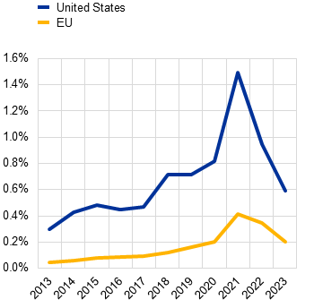
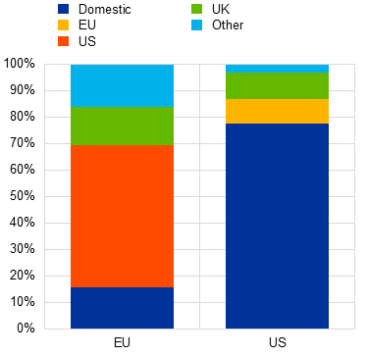
The role of other actors. Channelling funding towards innovative firms
VC markets underdeveloped and fragmented impacting depth of EU equity markets and innovation potential
VC financing as % GDP
VC in tech sector
1
Scale-up gap implies limited financing options for EU innovative firm at late stage
by investor’s country
2
Firms seek funding elsewhere – potentially listing, relocating
3
Impacts depth of EU equity markets which in turn affects pipeline of innovative firms
Source: ECB calculations on Pitchbook
Notes:
- high reliance of EU economy on bank lending is not optimal : (i) bank lending is not most adapted to finance young innovative firms; (ii) banks play a dominant role in financial markets but tend to lend to less profitable sectors (SRF analysis)
- VC on the other hand is more adequate tool for firms financing in early stages/risk taking but is underdeveloped in the EU vs US
- VC is underdeveloped as a share of GDP, fragmented across MS (small liquidity pools)
- VC investment is dominated by US investors in the EU – this is the case for investment in tech industry which is key for EU productivity (shown here) but also more generally for large late rounds of VC funding (equity project)
which leads companies to seek funding abroad. Reliance on external funding has implications for strategic autonomy.
- impacts the pipeline of firms able to scale and dynamics for equity/VC markets – with broader implications for CMU.

Slide 14





Financing throughout the lifecycle
Existing and new tools to finance innovation throughout the firm cycle
Short-term
Medium-term
Expand role of public investors (e.g. European Investment Bank tools)
Complement with private investors (pension funds, insurers, retail)
Connect supply and demand for VC capital (innovation hubs)
Increase attractiveness of EU equity markets (firms’ full pipeline)
Notes:
This leads us to our proposals to ensure that firms have access to the appropriate financing sources across their lifecycle. Key priority: develop VC market and channel funds into productive sectors.
This means leveraging on existing tools (EIB/EIF) to:
crowd-in investors as their presence can be perceived as a signal of quality
ensure strategic investment in key sectors
provide stability in volatile times (VC is risky and needs long term horizon)
Increasing the investor basis:
Addressing potential obstacles for institutional investors to play a more active role.
Incentivise retail investors to enter the market (e.g. through the savings products).
Over the medium term:
Connect supply and demand for VC financing:
innovation clusters are key to connect research-ideas-funding-support for commercialising ideas. The EU lagging behind such clusters.
Reflect on factors that can support the attractiveness of EU equity markets
Pipeline of firms
Draw lessons from US’ ability to attract foreign companies

Slide 15
Flexibility within unity: use all available tools
Potential combination of approaches
28th regime
Optional EU legal framework available alongside existing national frameworks
Two-tier approach
Subset of actors subject to EU rules based on harmonised criteria
Enhanced cooperation
Subset of Member States pursuing deeper integration as a group
Each actor (company, firm, etc) decides to opt-in (or not).
EU-centralized choice on actors under EU or national framework
Agreement at Member State level
Facilitate progress but add complexity
Incentives to opt-in (for take-up) vs mandatory criteria
Potential for improvements to national frameworks
Vanguard signals need for change
Differentiated integration

Slide 16
Crucial complements
Essential to foster CMU, but progress will take longer...
Safe asset
Several benefits of risk-free benchmark to support market development and decouple from domestic dynamics: permanent issuance is a key feature
Banking Union
More resilient, efficient and competitive banks for deeper capital markets and finance EU priorities
More cross-border banking to reduce fragmentation and bank-sovereign nexus (lower risks and costs for banks)
Financial literacy
Broader participation from households, SMEs
More trust in capital markets, more funds to real economy

Slide 17
What’s next?
ECB-CONFIDENTIAL
ECB actively supporting Commission’s efforts to implement proposals
Analytical and policy deep-dive
“An assessment of the benefits of equity markets and policy implications for Europe’s capital markets union”, forthcoming publication
Savings product, preliminary work on existing products
Capital markets supervision
Role of institutional investors for VC financing (and CMU)
Identify barriers to capital markets integration, and related costs
Tokenisation and CMU
Internal CMU task force
Reply to Commission’s consultation on SIU
Ongoing work to support the Commission and broader debate, especially on possible models for EU supervision of capital markets

Slide 18
Annex

Slide 19
ECB staff response to the securitisation consultation
EU securitisation markets: true-sale stable (funding) vs increased use of synthetics (capital relief); limited placement
Issuance of EA true-sale, synthetic securitisation, and of covered bonds (EUR bn notional)
Key messages:
Focus on risk transfer/create space on bank’s balance sheet
Standardisation to scale
Potential role for platforms
Focus on regulatory changes (due diligence/reporting)
Supervision and simplification
Fine-tune prudential treatment
Source: JP Morgan, European Covered Bond Council (ECBC), AFME, SIFMA, ECB Banking Supervision and ECB calculation
Notes:
Note: Chart shows total issuance of placed and retained. Market placed includes CLOs.
Decrease in private sector true-sale securitisation issuance vs pre-GFC in EA and US; key role of government sponsored entities in the US
EA post-GFC structural shifts: (1) ABS resilient while RMBS ~ replaced by Covered Bonds; (2) RMBS and CBs used for Eurosystem refinancing: kept on banks’ balance sheet); (3) rise in synthetics use: unclear how much capital release is channeled into funding productive sectors
Decrease in private sector true-sale securitisation issuance compared to pre-GFC in EA and US; key role of government sponsored entities in the US
Post-GFC structural shifts in the EA: (1) ABS resilient while RMBS ~ replaced by Covered Bonds; (2) high share of RMBS and CBs used for Eurosystem refinancing (i.e. kept on banks’ balance sheet); (3) rise in synthetics use (overtaking true sale for risk transfer)
While acknowledging structural differences, the increase in capital charges in the EU and JP did not appear to have negatively impacted true-sale securitisation issuance. Rather, central bank policies and availability of competing funding (covered-bonds) and risk-transfer (synthetics) alternatives seems to have had more impact.

Slide 20
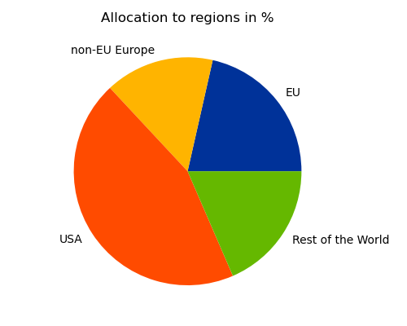
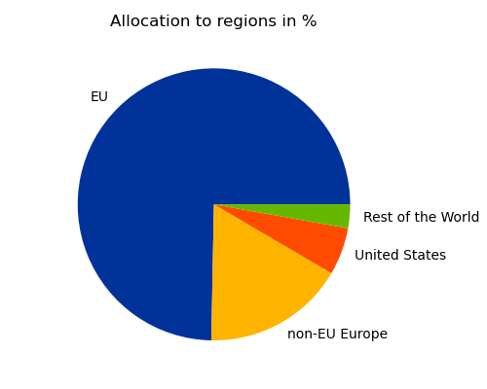
Addressing the trade-off between investment costs and investment objectives
Setting even a low threshold for minimum EU investments (e.g. 20%) for eligible funds under a European savings product captures most low-cost funds with a European focus
A) Geographic allocation of low-cost funds (TER below 0.5%)
B) Low-cost funds with at least 20% invested in EU stocks
See Banu, E., Evrard J., Schmidt, D., Wedow, M., forthcoming ECB Blog, “Can we kill two birds with one stone? On the trade-offs of an EU savings product.”
Sources and notes: Lipper for Investment Management data. The charts show the fraction of investments by geographical region for the respective sample of investment funds. Panel A considers all equity and mixed funds with a total expense ratio (TER) below 0.5%, regulated under the Undertakings for Collective Investment in Transferable Securities (UCITS) Directive and available to retail investors in at least one EU member state. Panel B further restricts the sample of investment funds to those with at least 20% investments in equity of EU companies.

Slide 21
Five key priorities for the next legislative term
SIU strategy by the Commission is broad in scope; 5 priorities from ECB point of view
ECB: 5 priority areas
COM SIU: 5 topics (4 CMU + 1 BU)
European savings standard
Trading and post-trading, digital tools
Integrated supervision
Securitisation
VC financing to support innovation
Citizens and savings
Investments and financing (including securitisation)
Integration and scale (including trading and post-trading)
Efficient supervision in the single market
Competitiveness and integration of the banking sector

