Slide 1
Impacts of EU elections on Capital Markets & European priorities for the next 5 years
A CFO perspective
BNP Paribas – Global Official Institutions Conference 2024
Kalin Anev Janse, Chief Financial Officer; Member of the Management Board, European Stability Mechanism
Paris, France on 20 June 2024

Slide 2
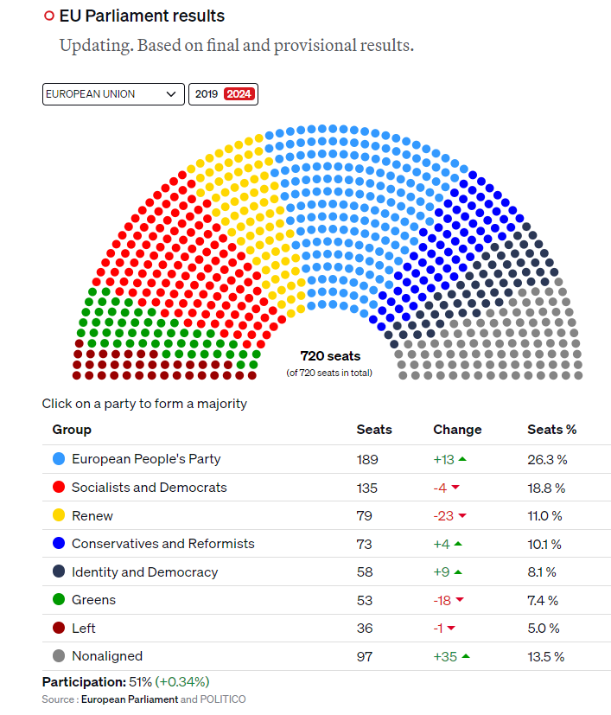
10th European Parliament elections: shift to the right
1
A large democratic process
357 million eligible voters, 27 countries electing 720 seats
51% turn out
Some countries, like Belgium and Bulgaria combined it with national elections
The winners
Conservatives (EPP) – U. von der Leyden “We have won”
Populist parties at around 30% of the new EP compared with around 23% in the old EP
Liberals and Greens lost most
Who was hit most?
Liberals (largely driven by France)
Greens (largely driven by Germany)
2
3
Bottom line: a shift to the right

Slide 3
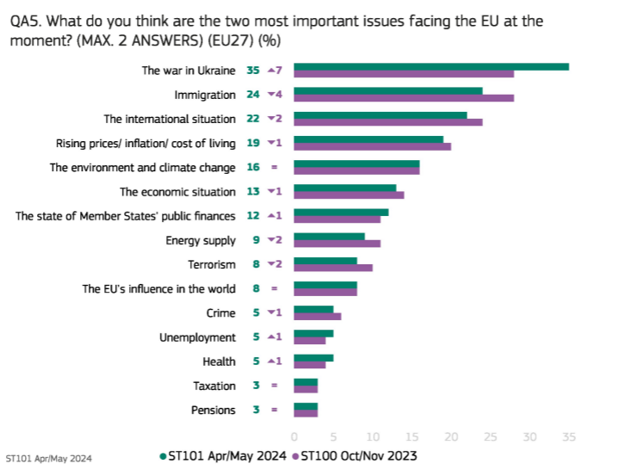
Main concerns Europeans – APRil - May 2024
War in Ukraine
Immigration
International situation
(Economics, finance and inflation come later)
Eurobarometer 101 April - May 2024

Slide 4
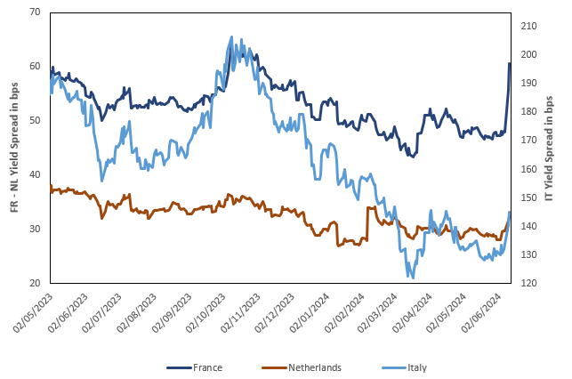
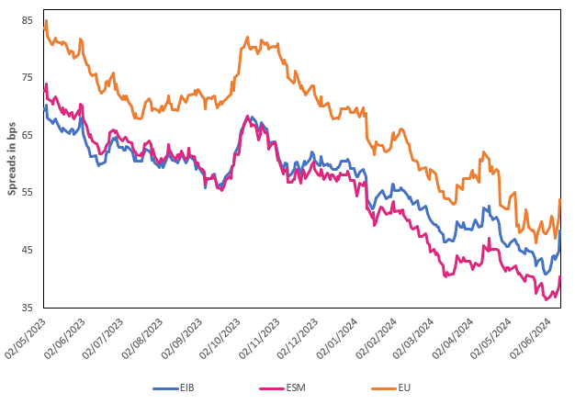
Market reaction was mainly driven by france
10-year Yield Spreads vs Germany
10-year E-names Yield Spreads vs Germany
Source: Bloomberg
Market reaction focused on France
Combination of fiscal and election uncertainty, including latest down grade
Populism does not mean bad market reactions, see The Netherlands after populist landslide win Nov 2023
Market reactions muted due to sound fiscal policies and market acceptance

Slide 5
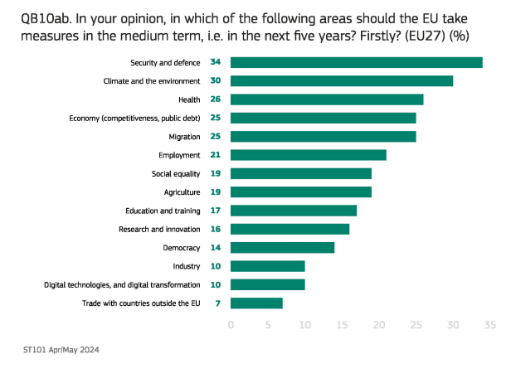
Priorities of Europe set to change
The shift to the right, could mean a refocus to:
Defence and Security (migration)
Strategic independence and competitiveness
Single Market / Capital Markets Union
Enrico Letta, Noyer and Draghi report a pointing in this direction
Eurobarometer 101 April - May 2024

Slide 6
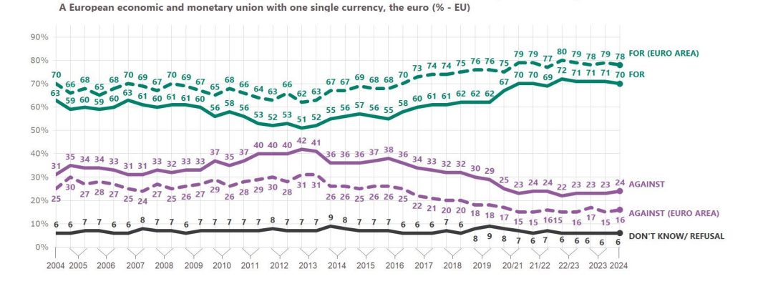
Europe is in a stronger position…
Economically doing better; ECB first cut in rates June 2024
Support of Economic and Monetary Union & Euro is high

Slide 7
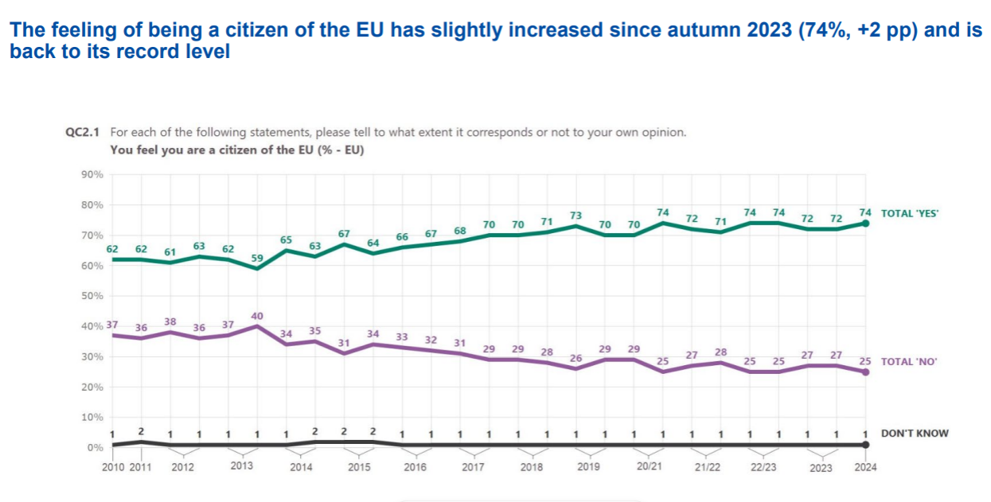
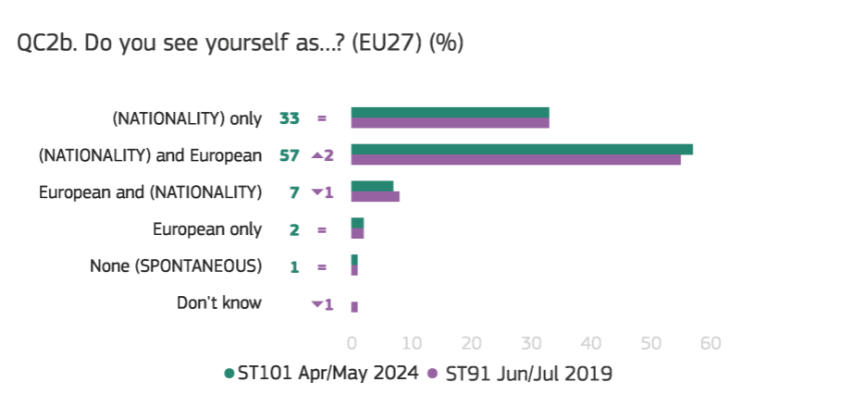
… MORE PEOPLE FEEL EUROPEAN …

Slide 8
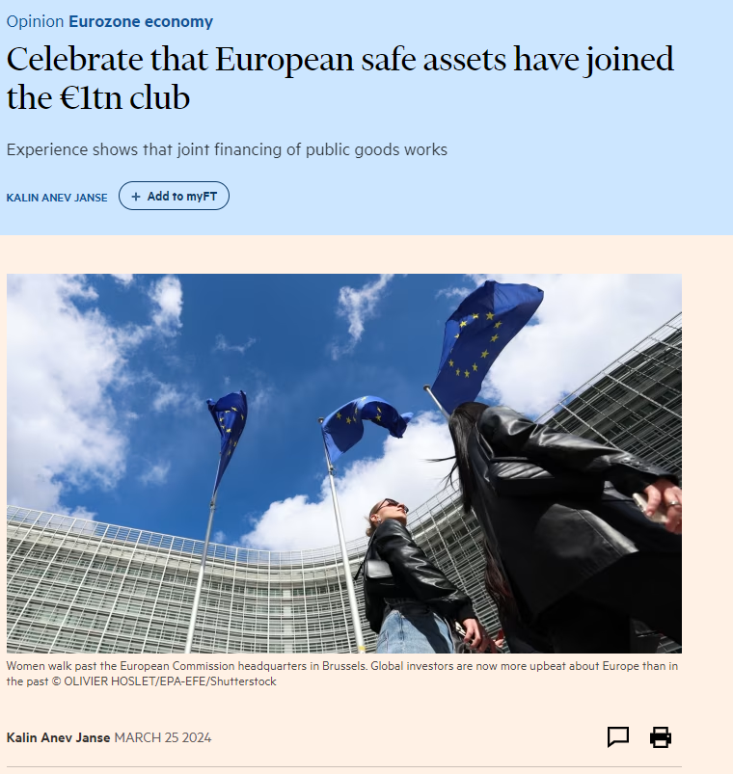
… AND WE HAVE MORE FIREPOWER FOR THE NEW PRIORITES
Just crossed EUR 1 trillion European Safe Assets from EU/EIB/ESM+EFSF
Just 36% of the available capacity
€2 trillion plus can be deployed
ESM has €422 billion available, and growing due to repayments
Funds are available for new priorities

Slide 9
Final words
We might get more Europe than less out of these elections, but the priorities might be different
The previous round 2019-2024 was around the Green Deal and Covid response
The next one more around defence/security, strategic independence/competitiveness and CMU / Single Market
We have the architecture, institutions and firepower to fulfil the new needs

Slide 10

Kalin Anev Janse
Member of the Management Board, Chief Financial Officer
LinkedIn, X and Insta: @kaanev

