Slide 1
Declining home bias fosters capital market integration
Dirk Schoenmaker
Rsm & Bruegel
ESM, 8 DECember 2017

Slide 2
Outline
From banking to institutional investment
Institutional investment and capital markets
Capital markets and home bias
Policy conclusions

Slide 3
Banking remains flat

Slide 4
Institutional investment on the rise

Slide 6
Empirical tests
Hypothesis 1
  More institutional investment leads to larger markets
  Markets measured in terms of equities and bonds
Hypothesis 2
  More institutional investment leads to better risk sharing
  Risk sharing measured as lower home bias

Slide 7
Hyp 1: more investment, larger equity market

Slide 8
Hyp 1: more investment, larger bond market

Slide 9
Hyp 2: institutional investment and risk sharing
Regression results show that lower home bias is associated with:
  higher institutional investor assets-to-GDP ratio;
  lower restrictions on foreign investments of pension funds;
  Controls:
  higher GDP per capita, broadly measuring the level of development;
  higher export to GDP ratio, aiming to capture the openness of an economy;
  lower home market capitalisation, as a share of domestic GDP (less domestic supply);
  higher foreign market capitalisation, as a share of domestic GDP (more foreign supply).

Slide 10
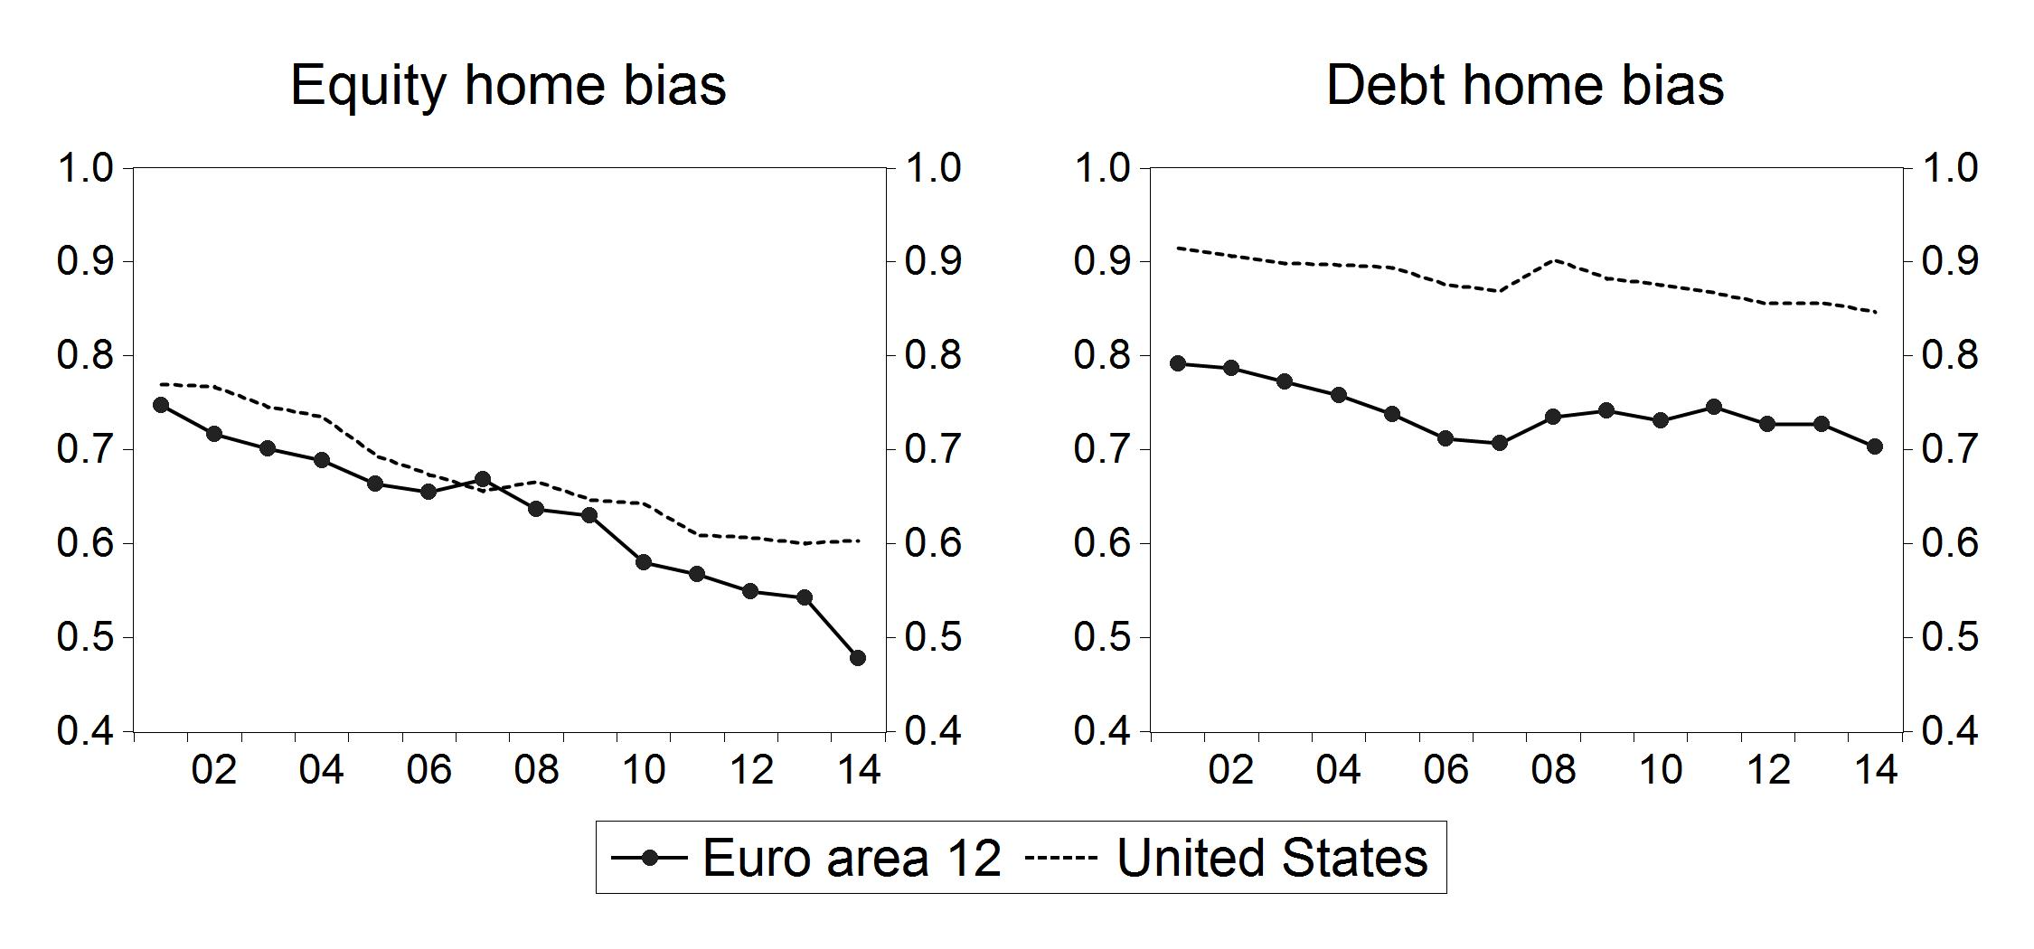
Declining home bias
home bias = 1 – share foreign equity in country i/share foreign equity in world portfolio

Slide 11
Policy conclusions
Financial intermediation
  Banking remains flat: reducing overbanking
  Rise of institutional investment: bottom-up approach
Institutional investment and capital markets
  Institutional investment develops capital markets
  And better risk sharing: declining home bias -> integration
How to further foster integrated EU27 capital market?
  Regulatory framework: capital markets union
  Stronger role for ESMA: top-down approach

Slide 12
Reference
Darvas, Z. and D. Schoenmaker (2018), ‘Institutional Investors and Development of Europe’s Capital Markets’, in: E. Avgouleas, D. Busch and G. Ferrarini (eds), A Capital Markets Union for Europe, Oxford University Press, Oxford, forthcoming.

