Slide 1
Association for Financial Markets in Europe
Addressing the Shortage of Risk Capital for Europe’s High Growth Businesses
ESM Workshop on Cross-Border Capital Flows and Capital Markets Union
Rick Watson
Managing Director, Head of Capital Markets, AFME
8 December 2017

Slide 2
Themes
SMEs and Growth companies are different, and have different needs
There is a general gap in the availability of all forms of risk finance in the EU
There is significant fragmentation between the approach taken to address this shortfall by member states, and also between funding escalator levels

Slide 3
The shortage of risk capital in Europe
A fragmented market: entrepreneurs have access to a huge market of potential customers, but cannot take full advantage because of fragmentation in standards, legal frameworks and insolvency laws;
Significant amount of capital from Europeans could be invested in risk capital: 3m EU citizens hold non-real estate assets in excess of €1m and assets under management from retail stood at €4.9tn, representing 26% of the total European assets under management;
A need for a single framework for equity crowdfunding which is growing in Europe with €354m invested in Europe;
Under-developed business angel capacity:
Business angels in the US invest in twice the number of businesses in Europe.
Only 12 Member States have tax incentives for early-stage investments;
Insufficient venture capital funding:
European companies received €1.3m on average from VC compared to €6.4m in the US;
VC funds in Europe invested €4.1bn compared to €26.4bn in the US on average between 2007-15;
Only 44% of EU Venture Capital (VC) investments went to later stage businesses compared to almost 2/3 of all VC investments in the US;
Venture debt is underutilised: 5% of VC-backed EU companies obtain venture debt financing compared to 15-20% in the US and 8-10% in the UK;
A sluggish primary equity market:
Businesses raised €2bn through IPOs in junior exchanges and €8.5bn by follow-ons in 2015. This compares to €24.1bn and €14.1bn respectively in the US;
A majority (61%) of European listed companies have market capitalisation of less than €200m compared to just 46% in Hong Kong and 39% in US emerging growth companies.

Slide 4
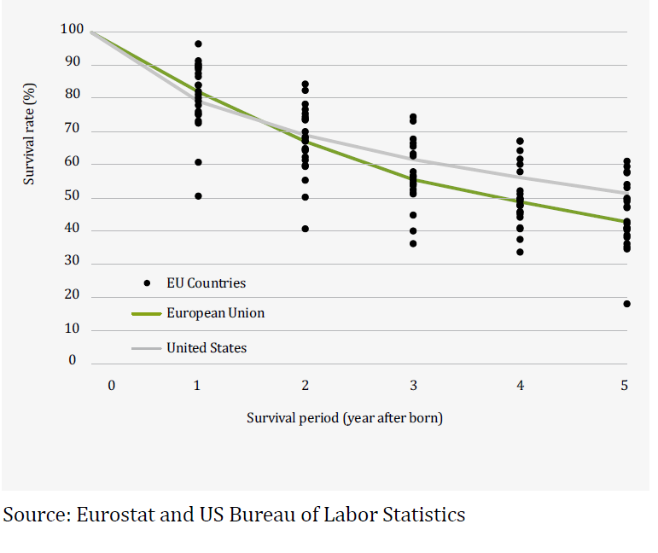
Thinking about SMEs
Business survival rates: European Union
and United States
Concentration of job creation (UK)
Source: Nesta, 2009

Slide 5
A big market for SME finance, but not for growth
 | European Union | United States
Total stock of outstanding finance for SMEs | €2,007bn | €1,236bn
Share of bank finance | 77% | 40%
Listed market capitalisation | €10tn (53% of GDP) | €19tn (140% of GDP)
Venture capital investments | €4.2bn | €26.4bn
Business angels | €6.1bn | €22.7bn
Equity crowdfunding | €354m | €149m
Accelerators | €38m | €83m
Source: AFME

Slide 6
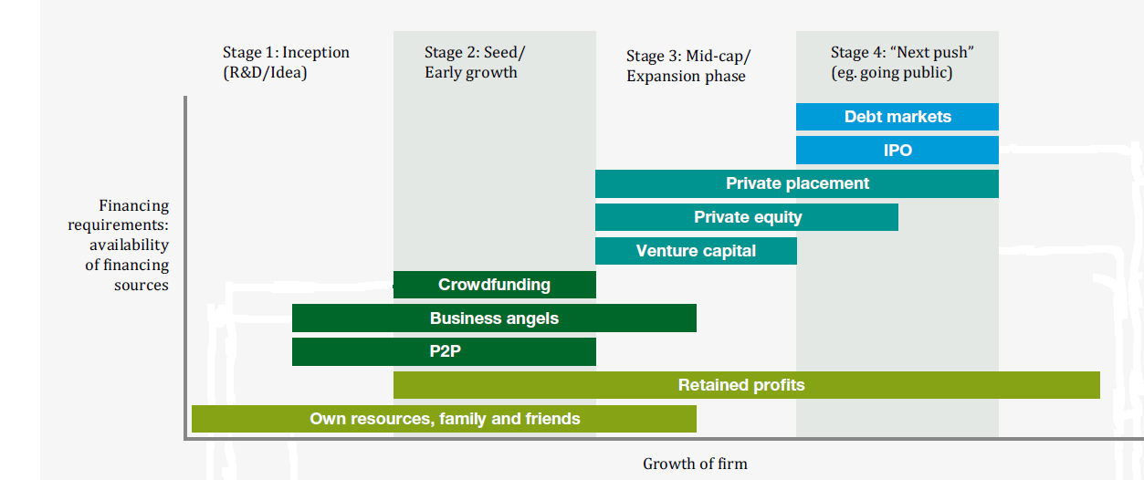
The EU “funding escalator” for high-growth companies

Slide 7
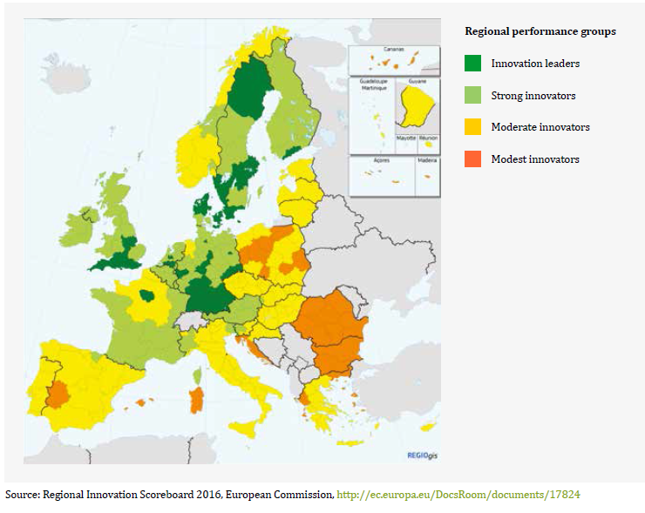
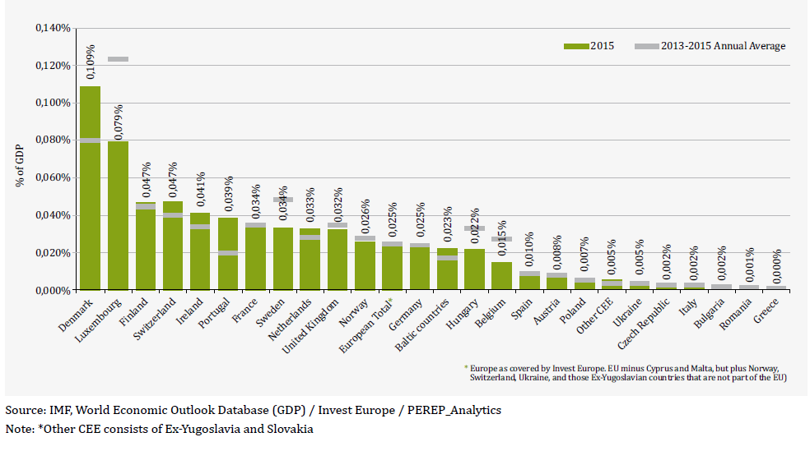
Innovation and venture capital are both fragmented
Innovation by region
Venture capital investment as % of GDP

Slide 8
Business angel activity in Europe and the US

Slide 9
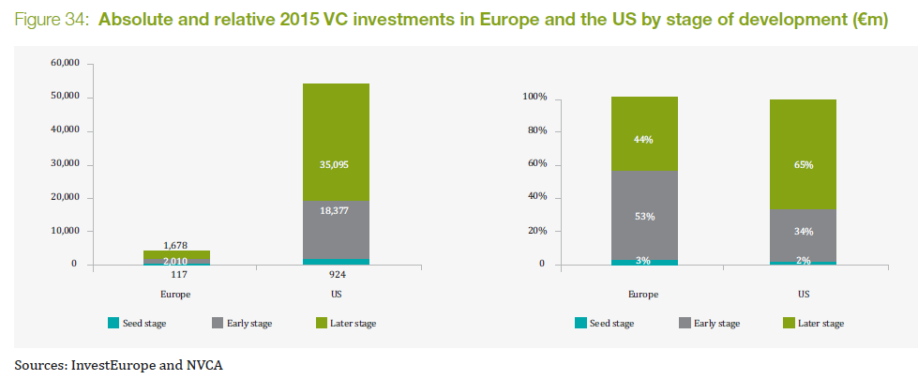
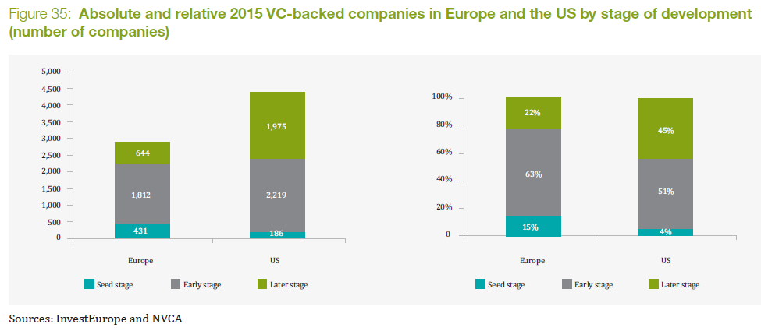
Venture capital investments in Europe vs. US

Slide 10
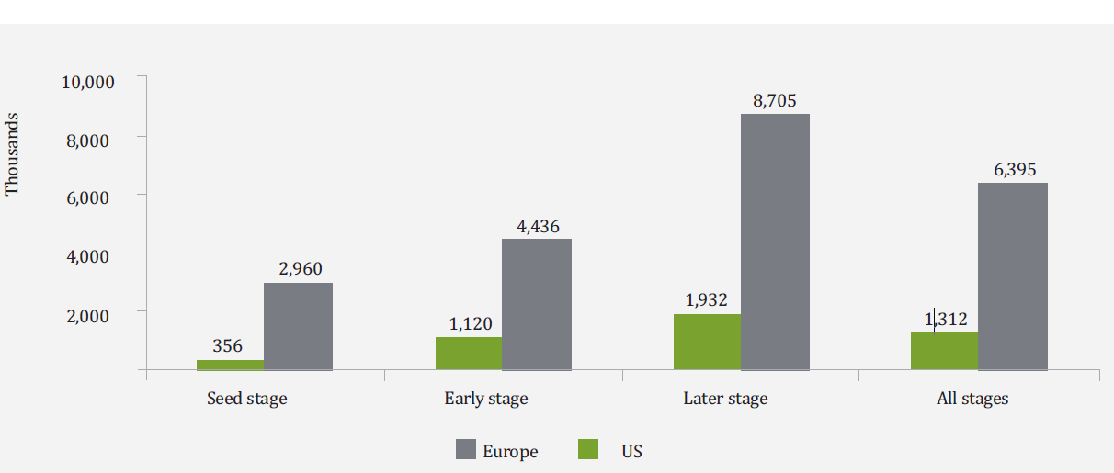
Too small to scale
Average invested in VC-backed transactions in Europe and the US (2007 – 2015, €000s)
Sources: AFME, InvestEurope and NVCA

Slide 11
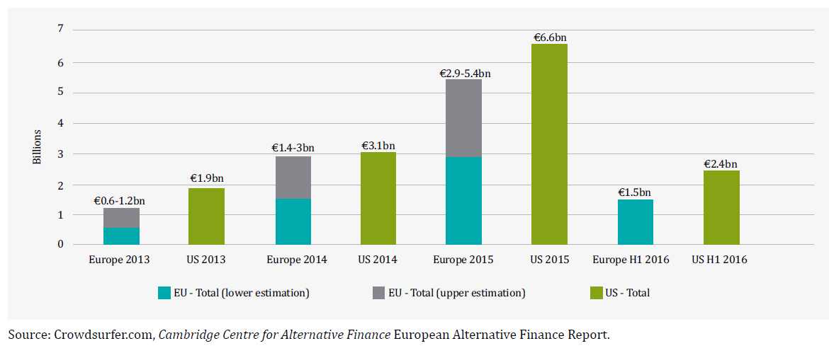
Crowdfunding – small but growing
EU vs US, 2013 – H1 2016
Data widely varies between the various sources of data for investments through crowdfunding platforms. Other sources include the Alternative Finance Benchmarking Report (E&Y, KPMG and University of Cambridge), Massolution.com. The data cited in the European Commission’s report on Crowdfunding comes from crowdsurfer.com.

Slide 12
Venture debt
Venture debt as a % of total VC - historic
Venture debt as a % of total VC - today
Source: BVCA
Source: E&Y

Slide 13
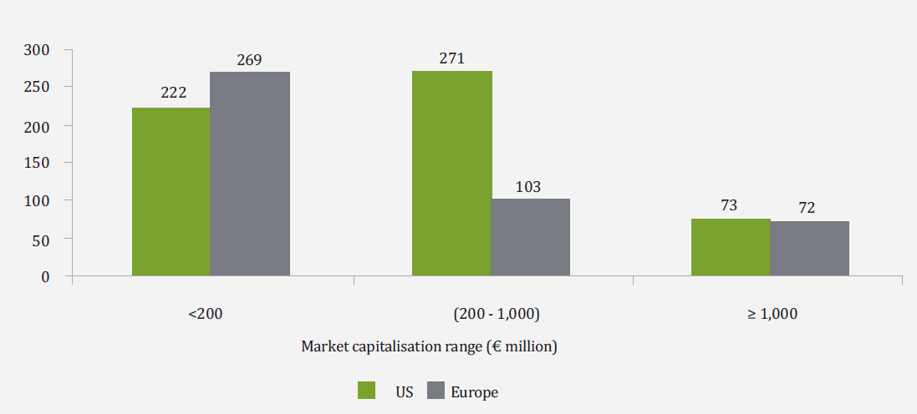
Primary Equity Markets
Number of IPOs in European main markets and MTFs and from US EGCs, 2012 – 2015
Source: AFME, Dealogic

Slide 14
Selected European Commission actions to address the shortage of risk capital
Crowdfunding | Potential introduction of a legislative framework (inception impact assessment)
Business angels and venture capital | Good practices on tax incentives for VC and business angels
Prospectus Regulation | Implementation measures
SME listing package | Explore through an impact assessment whether target amendments to relevant EU legislation can deliver a more proportionate environment to support SME listing on public markets
 | Assessment of the impact of MiFID II Level 2 rules on listed SME equity research
 | Monitor progress on IASB commitment to improve disclosures, usability and accessibility of IFRS
 | Develop best practices on the use by Member States of EU funds to partially finance costs borne by SMEs when seeking admission of their shares on the future SME Growth Markets

Slide 15
Offices
The Association for Financial Markets in Europe advocates stable, competitive and sustainable European financial markets that support economic growth and benefit society.
London Brussels Frankfurt
39th Floor Rue de la Loi 82 Skyper Villa 25 Canada Square 1040 Brussels Taunusanlage 1 London, E14 5LQ Belgium 60329 Frankfurt am Main United Kingdom Germany Tel: +44 (0)20 3828 2700 Tel: +32 (0)2 788 3971 Tel: +49 (0)69 5050 60590
www.afme.eu

